Slide 1
Leading at Speed
While the ground is shifting
Frank Teruel | Private and Confidential

Slide 2
Dynamism is endemic “everything is changing”
Frank Teruel | Private and Confidential

Slide 3
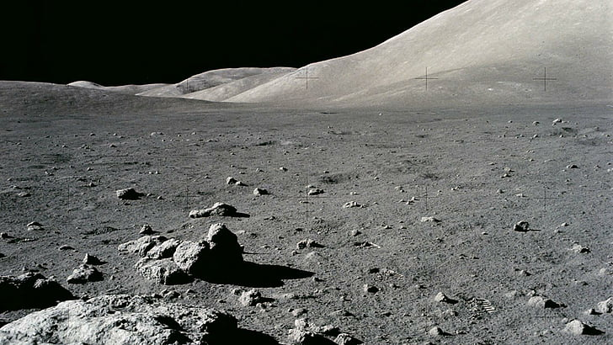
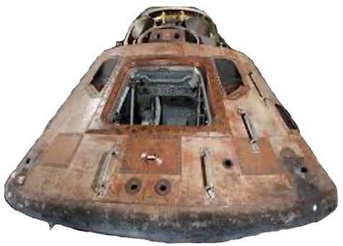
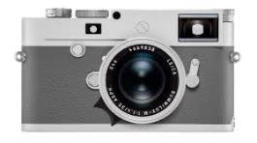
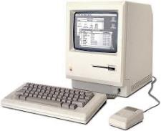
Technology | Power and Speed
iPhone 11
100K X processing power
1M X memory
Frank Teruel | Private and Confidential

Slide 4
Globe| accessible, interconnected
Trends
Idea
Market
Are you Online?
You’re Global!
Fraud
Product
& Ethics
Supply Chain
Brand
AI
Frank Teruel | Private and Confidential

Slide 5
Values| delivered digitally
Frank Teruel | Private and Confidential
Notes:
AI: Unintended Selection Bias

Slide 6
People | who are they?
ID
Rep
Blurred Lines
“Free $$”
Digital Native
Cause Driven
What NDA?
FWBNID
Silent Res.
Expect Tons… Quickly
Frank Teruel | Private and Confidential

Slide 7
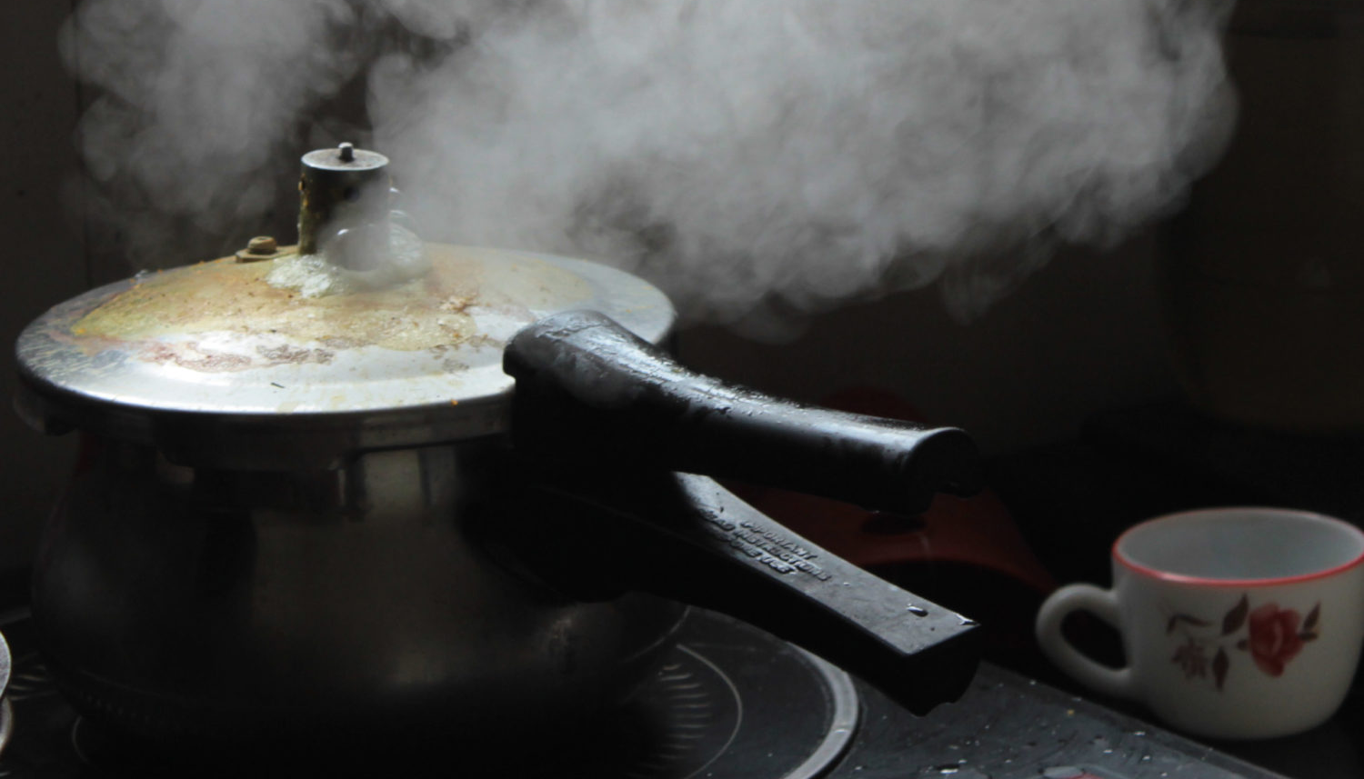
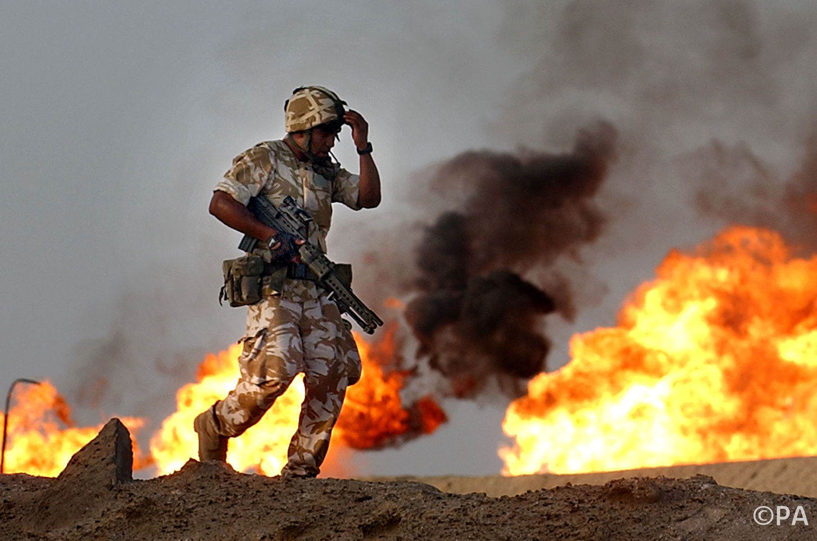
Experience | pressure
Frank Teruel | Private and Confidential

Slide 8
Responding to the world as it presents itself
Frank Teruel | Private and Confidential

Slide 9
roblem
P
dmiration
A
WOW
Now Focus
Tangled Mess
Hard Work
End of Job?
Frank Teruel | Private and Confidential

Slide 10
roblem
P
S
olving
Start at End
Easy Wins
Fail Fast
Plan B and C
Frank Teruel | Private and Confidential

Slide 11
Antagonist of Good
“I need to build a path”
“It needs to last”
Remove the trees
Over
Engineer
Build a Freeway??
Frank Teruel | Private and Confidential

Slide 12
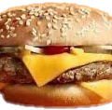
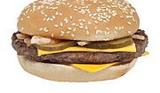
Data driven
1/3
1/4
Frank Teruel | Private and Confidential

Slide 13
The succession imperative
Who’s your #2

Slide 14
Be effective
“The effective leader is a person whose character, knowledge, and judgment command respect₁”
1 Adapted from Fundamentals of Speech, a study outline by Anna Lloyd Neal
Frank Teruel | Private and Confidential

Slide 15
Character Knowledge Judgment
Who you are!
What you know!
Applying the right knowledge to right circumstances at the right time
Frank Teruel | Private and Confidential

Slide 16
Thank You
“The person who can think and does not know how to express those thoughts is at the level of someone who cannot think₁”
QA
1 Attributed to Pericles and adapted

